Slide 1


CSE332 Industrial Ethics and Legal Issues
Ethical Behavior of IT Professional

Slide 2

Profession
A profession is a calling that requires specialized knowledge and often long and intensive academic preparation.
Professional ?

Slide 3
Professional Employee
One who is engaged in the performance of work .
Specialized intellectual instruction.
Exercise of discretion and judgement.

Slide 4


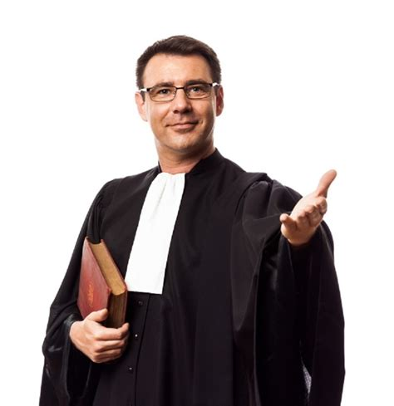
Professionals such as doctors, lawyers, and accountants require advanced training and experience; they must exercise Carefulness and judgment in the course of their work.

Slide 5
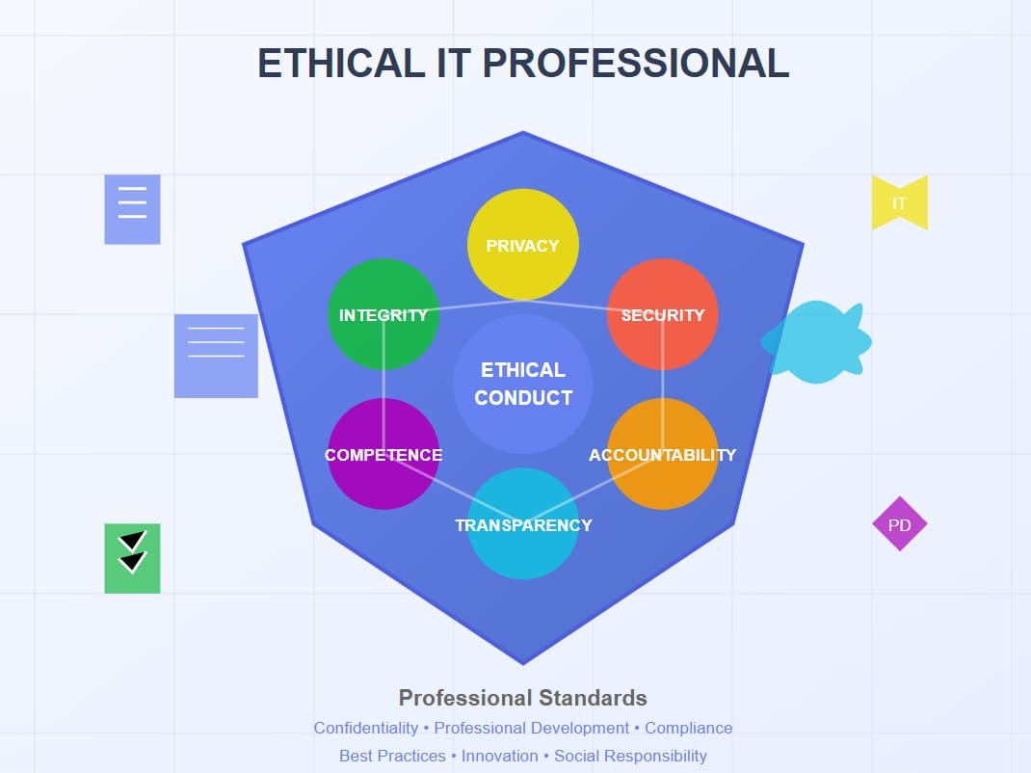

Are IT Workers Professionals?
Specialized Knowledge
Ethical Behaviour
Accountability
Commitment to
Continuous
Learning

Slide 6
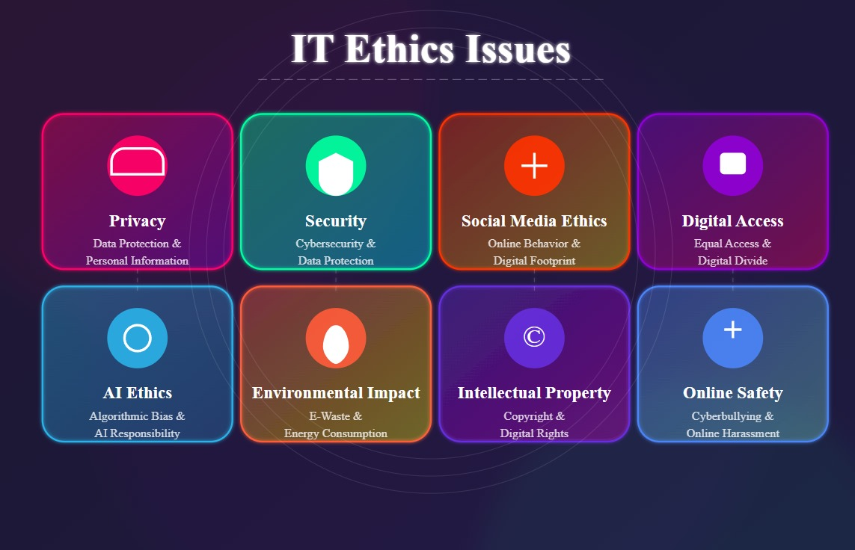
Common Ethical Issues For IT Users
Privacy Concern
Cybersecurity Risks
Misuse of IT Resource
Surveillance and
Monitoring

Slide 7
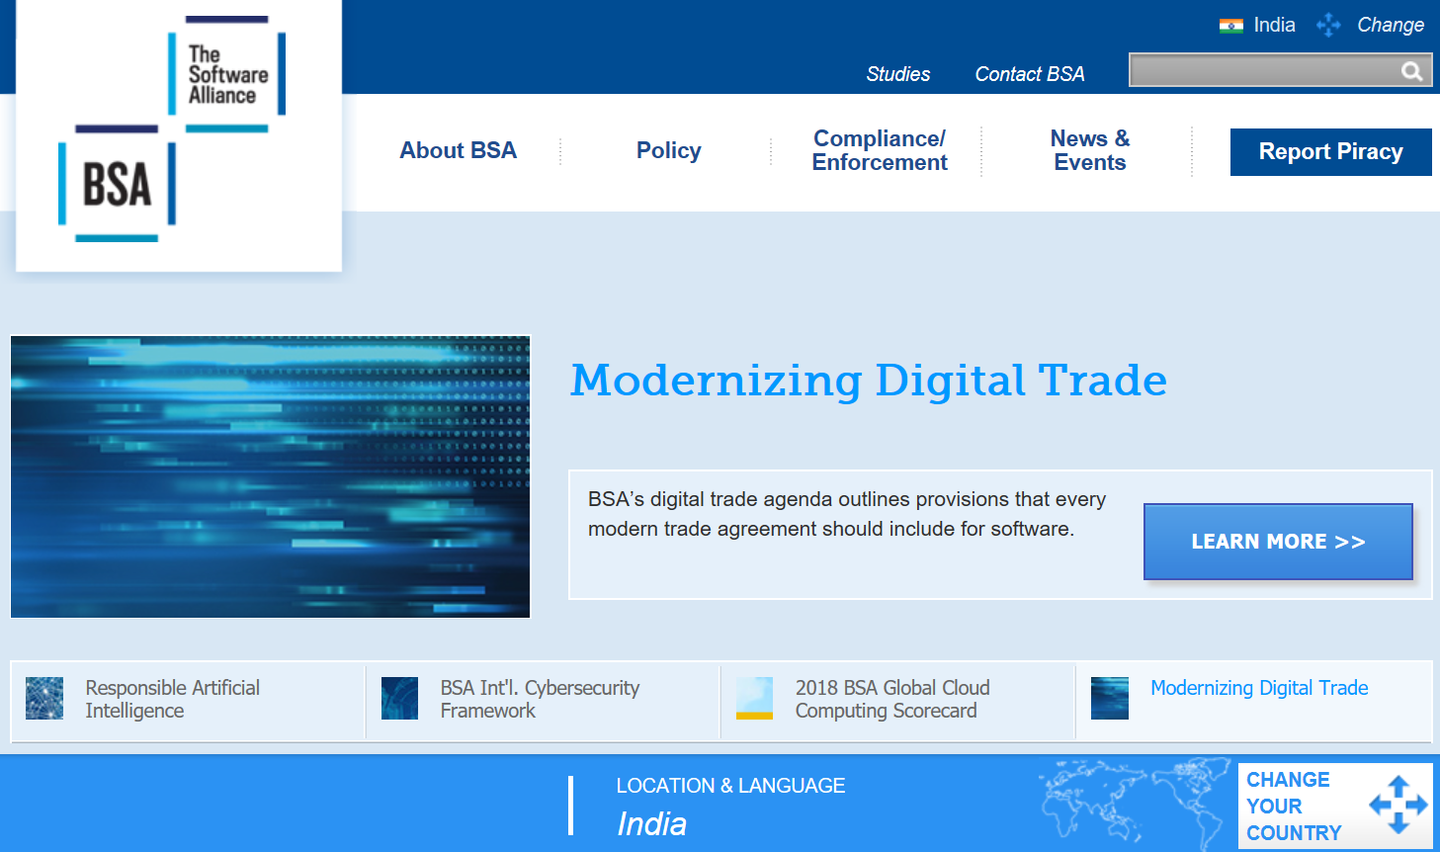
Business Software Alliance (BSA)
The Business Software Alliance (BSA) is a trade group that represents the world’s largest software and hardware manufacturers.
Its mission is to stop the unauthorized copying of software produced by its members.

Slide 8
More than 100 BSA lawyers and investigators prosecute thousands of cases of software piracy each year.
BSA investigations are usually triggered by calls to the BSA hotline, reports sent to the BSA Web site (www.nopiracy.org), and referrals from member companies.

Slide 9
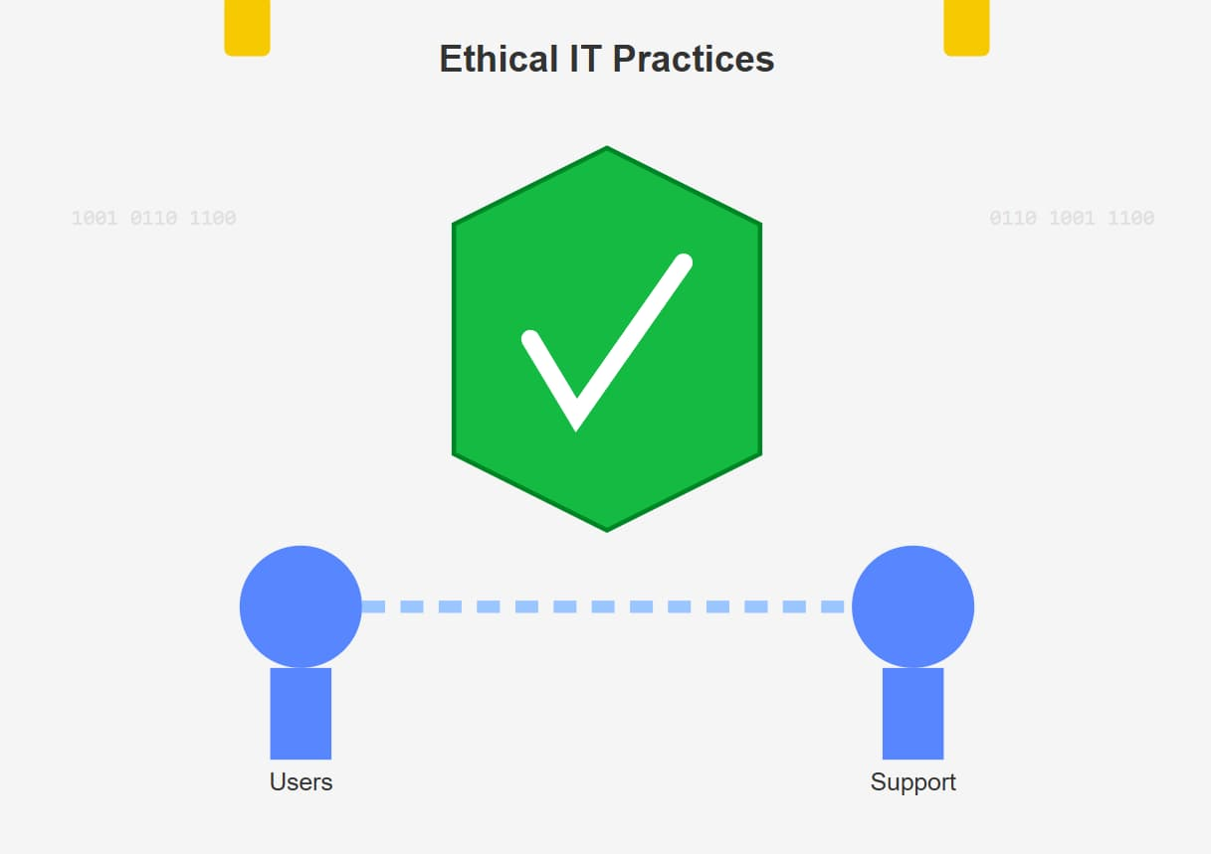
Supporting the Ethical Practices Of IT Users
Education And Awareness
Clear Policies and Standards
Access Control and Security
Ethical Use Of AI And Automation
Collaboration and community Involvement

Slide 10
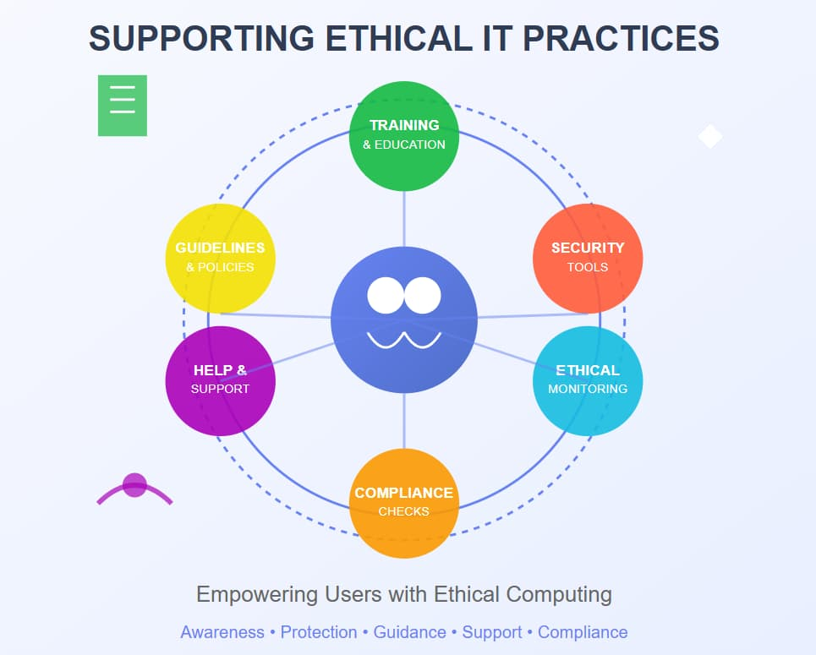
Supporting the Ethical Practices

Slide 11

NEXT TOPIC:
Women Empowerment
Ethical Aspects of Engineering Practices

